Slide 1
Façade Pattern

Slide 2
Facade Pattern
Provides a unified interface to a set of objects in a subsystem.
A facade defines a higher-level interface that makes the subsystem easier to use (i.e. it abstracts out the details)
Facades allow us to provide a closed architecture

Slide 3
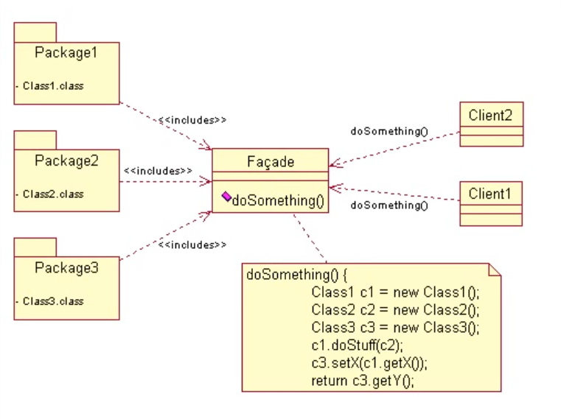
21-<number>

Slide 4
Design Example
Subsystem 1 can look into the Subsystem 2 (vehicle subsystem) and call on any component or class operation at will.
This is “Ravioli Design”
Why is this good?
  Efficiency
Why is this bad?
  Can’t expect the caller to understand how the subsystem works or the complex relationships within the subsystem.
  We can be assured that the subsystem will be misused, leading to non-portable code
Subsystem 1
Subsystem 2
Seat
Card
AIM
SA/RT

Slide 5
Realizing an Opaque Architecture with a Facade
VIP Subsystem
The subsystem decides exactly how it is accessed
No need to worry about misuse by callers
If a façade is used, the subsystem can be used in an early integration test
  We need to write only a driver
Vehicle Subsystem API
Seat
Card
AIM
SA/RT

Slide 6
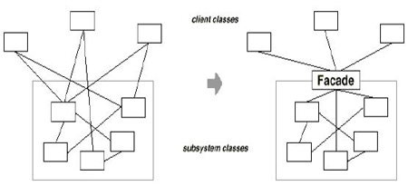
Motivation
10-<number>

Slide 7
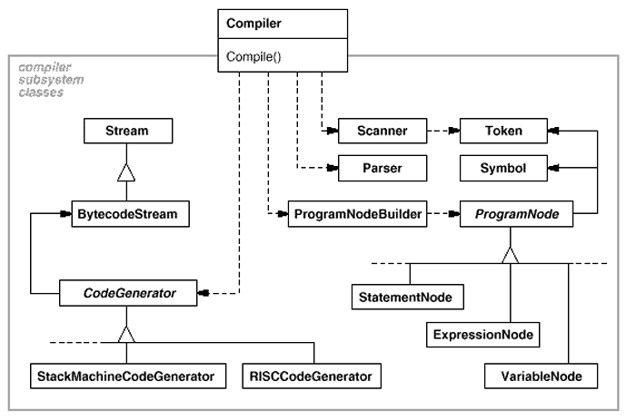
Example (GoF p. 186)
10-<number>

Slide 8
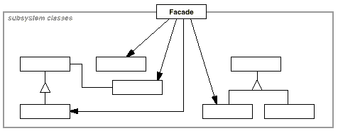
Structure
GOF p. 187
10-<number>

Slide 9
Facade – Simplifying Client Interface
Design of a reverse engineering tool:
Graphical User Interface
Source
Parser
Graphical
Layout
Graphical
Display
source
code
classes &
relations
Layout
info
A user has to invoke three components to reverse engineer a set of source files.
How to simplify the client interface?
21-<number>

Slide 10
Facade Pattern
Facade simplifies the client interface.
It assumes the responsibility to interact with a set of objects for the client.
client:
obj 1:
obj 2:
obj 3:
client:
:Facade
obj 1:
obj 2:
obj 3:
m1
m
m1
m2
m2
m3
m3
m4
m4
m5
m5
m6
m6
Without using facade
Using facade
It is useful for software maintenance.
21-<number>

Slide 11
Benefits of Facade Pattern
It hides the complex interactions from the client.
It makes the system components easier to reuse.
It reduces the coupling between the client and the system components.
It reduces the impact of changes to the system components.
The client can still access to the system components.
21-<number>

